Slide 1

Grads of 2025
Gr 10 to 11
Course Selection

Slide 2
Counsellors role in Course planning
Counsellors help students with their course selections and make timetables, but we are fairly neutral when it comes to recommending courses. It is better to talk to teachers, read the course planning book on our website and make an informed
choice by doing research
I will enter all the courses written in your MS Forms submission
Students will get all REQUIRED courses

Slide 3

COURSE PLANNING 11
1–19 Feb, 2023
Course Planning – will be done online, open from February 1 – 19, 2023
19 Feb. 2023
Due Date for completion of MS Teams Course Selection Form is February 19, 2023
Feb 1, 2023
Course Planning Question and Answer Night via MS Teams (link in Grade 10 Channel), 4:30-5:30pm
Feb 9, 2023
Course Planning session at FIT time in the Auditorium

Slide 4
WHAT DO I NEED TO GRADUATE?
80 credits (most courses are 4 credits each)
Hint: You need to pass the course to get the credits!
52 credits from the required grade 10-12 academic classes you will take, as well as CLE 10, CLC 11/12, and PHE 10.
28 credits from all your electives
*make sure you take at least one elective in Applied Skills if you are mostly taking Fine Arts
electives, or vice versa
** at least 16 credits must be at the grade 12 level (which includes your required English 12 class)

Slide 5
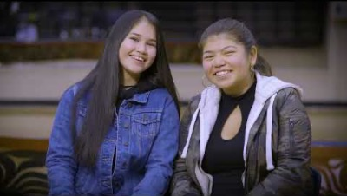

Slide 6
NEW!!!! WHAT DO I NEED TO GRADUATE? NEW!!!!!!
INDIGENOUS GRADUATION REQUIREMENT
All Students must take 4 credits of Indigenous-focused coursework during their high school studies in order to qualify for graduation.
For your particular grade you have must take at least one (1) of the following classes:
    English First Peoples 12 (can replace English Studies 12) in Grade 12
    OR
    First Peoples Social Studies 12 (can be used as your Social Studies Grad requirement) in Grade 11 or 12

Slide 7
Graduation Requirements for Grade 11
Any English: Literary Studies 11/New Media 11
Any Math 11: Pre-Calculus 11/Foundations of Math 11/ Workplace Math 11
At least 1 Science 11: Life Science 11/Chem 11/Physics 11/ Environmental Science 11/Science for Citizens 11
Exploration of Social Studies 11
Language 11/ skills 11/Elective
3-4 Elective courses, some are off timetable
Career Life Connections 11 (this will be off timetable)

Slide 8
Which English course do I take?
You MUST take one English 11 class, you have two choices (all are accepted for post-secondary)
Literary Studies 11
New Media 11
In Grade 12, students will take English Studies 12 or English First Peoples 12

Slide 9

What About Math?
Workplace Math 10 students will go into Workplace Math 11, this will be sufficient to graduate and enter SOME trades courses
Workplace Math 10 → Workplace Math 11
Students in Foundations of Math and Pre-Calculus 10 can choose one of two pathways (see next slide)

Slide 10
Math Pathway Continued…
Found of Math/
Pre-Calc 10
Found of Math 11
Pre-Calc 11
Found of Math 12
Pre-Calc 12
    Which one do you need to take?
    Answer: It depends on where you are going…

Slide 11
Science
You must have at least ONE Grade 11 Science in order to graduate, options include:
    Life Sciences 11 (formerly Biology 11)
    Chemistry 11
    Physics 11
    Environmental Science 11 (new course!)
    Science for Citizens 11 (formerly Science and Technology 11)

Slide 12
Social studies
Recommended that students take Exploration of Social Studies 11 (formerly Social Studies 11)

Slide 13
CAREER PROGRAMS/ TRADES
If you think you may be interested in trying out a trade or career program, or simply want to learn more, you can chat with:
Mr. Lee (generally)
Mr. Hamilton (Tupper Tech)
Chef. Regan (Chef program)
Mark from VSB Career Programs [mreid@vsb.bc.ca 604.992.4963] (expert on all programs!)
*Application deadlines for next years’ programs are generally March 1st .

Slide 14
Various Youth Train in Trades and Career Programs offered by the VSB
Youth Train in Trades and Career Prep Programs
  Tupper Culinary Arts (12)
  Automotive mechanical and bodywork (12)
  Baking at VCC (12)
  CISCO Networking academy (11?/12)
  Industrial Design (11/12)
  Fashion Design (11/12)
  Tupper Tech (12)

Slide 15
Career Life Connections 11/12
This is an Off timetable course that will be delivered in 2 parts. 1st portion in Grade 11 and the other in Grade 12.
Both CLC 11 and 12 are worth 2 credits each
These courses will be delivered during the school year with 6-10 assignments throughout the year
Students will be assigned to a teacher, to which they will submit their assignments

Slide 16
HOW SHOULD I DECIDE WHAT COURSES TO TAKE NOW TO GET INTO POST-SECONDARY LATER?
Look at the admissions requirements for the various post-secondary spots where you’re interested in going.
See what courses they require you to have, and which ones are suggested, but optional.
If you’re confused, see me and, we can talk about where to find information

Slide 17
WHAT IF I FAIL SOMETHING OR MAKE THE WRONG CHOICE IN GRADE 11?
No problem. You have tons of options!
Summer school
Repeating the course next year
Going to college first before university
Choosing a different path, learning something about yourself you maybe didn’t know, getting life experience.
*PLEASE remember that your life isn’t ruined if your path to post-secondary, or even graduation, goes a little differently than you thought it would. You have support!

Slide 18
COLLEGE/ UNIVERSITY
Research Degree and certificate programs.
Research entrance requirements
Find out what Grade 11 and 12 courses you need.
Canadian Universities Event (CUE) – Usually in the first week of October brings over 50 of the best Canadian post-secondary schools together in one place (Mr. Lee will send a notice in the fall)

Slide 19
Courses needed for Direct University Entrance
Literary Studies 11/New Media 11 and English Studies 12/English First Peoples 12
Pre-Calculus 11 and 12 (or Foundations 12 depending on school/faculty)
A Language 11 (school dependent)
Life Science11or Chemistry11 or Physics 11 or Environmental Science 11(depending on school/program)
At this time, Workplace Math and Science for Citizens do not lead to direct entry

Slide 20
Grade 12 Courses Required for Direct Entry to University
English Studies 12/English First Peoples 12
3 of the following courses (which 3 depend on area of study you are applying to)
Anatomy and Physiology (formerly known as Biology 12) or Chemistry or Physics 12
Geography 12
History 12
A Language 12 (certain faculties)
Literature 12
Pre-Calculus Math 12
Calculus 12
Law 12
BC First Peoples 12

Slide 21
College programs (university transfer programs)
Apply early on in your Grade 12 year (October 1)
Basic high school graduation requirements (C average or higher)
Typically smaller classes
Tuition is less expensive
Can transfer in third year to university

Slide 22
What if I don’t know what I want to do ?!
Don’t worry, it’s ok if you don’t have it all figured out.
Think about the things you ‘don’t’ want to do and use that as a starting point.
People change their mind/ career path all the time---open yourself to new ideas/ opportunities, take some general classes to help you figure out a focus.

Slide 23
Electives
Think Career/ Think of your passions
What courses really interest you?
Make informed choices!!!!!
Read the course planner carefully
Are you applying to post-secondary? You will need very specific courses, research it!

Slide 24
What now?
Read the planners online
Talk to your parents/guardians
Make individual appts with your counsellor if necessary
Talk to your teachers--especially Youth Train in Trades and Tupper Tech hopefuls---research the courses and make informed choices.
See Ms. Ma about work experience
If you have questions, I want to HEAR FROM YOU !!

Slide 25
Course Planning book 2023-2024
Can be found on the Tupper Website under Course Planning, go to:
Tupper Website → Guidance and Support (top tab) → Course Planning → Course Planning Book 2023-2024
Pages 4 and 5 will list ALL ELECTIVES AVAILABLE, then you can look each individual choice up on the following pages

Slide 26
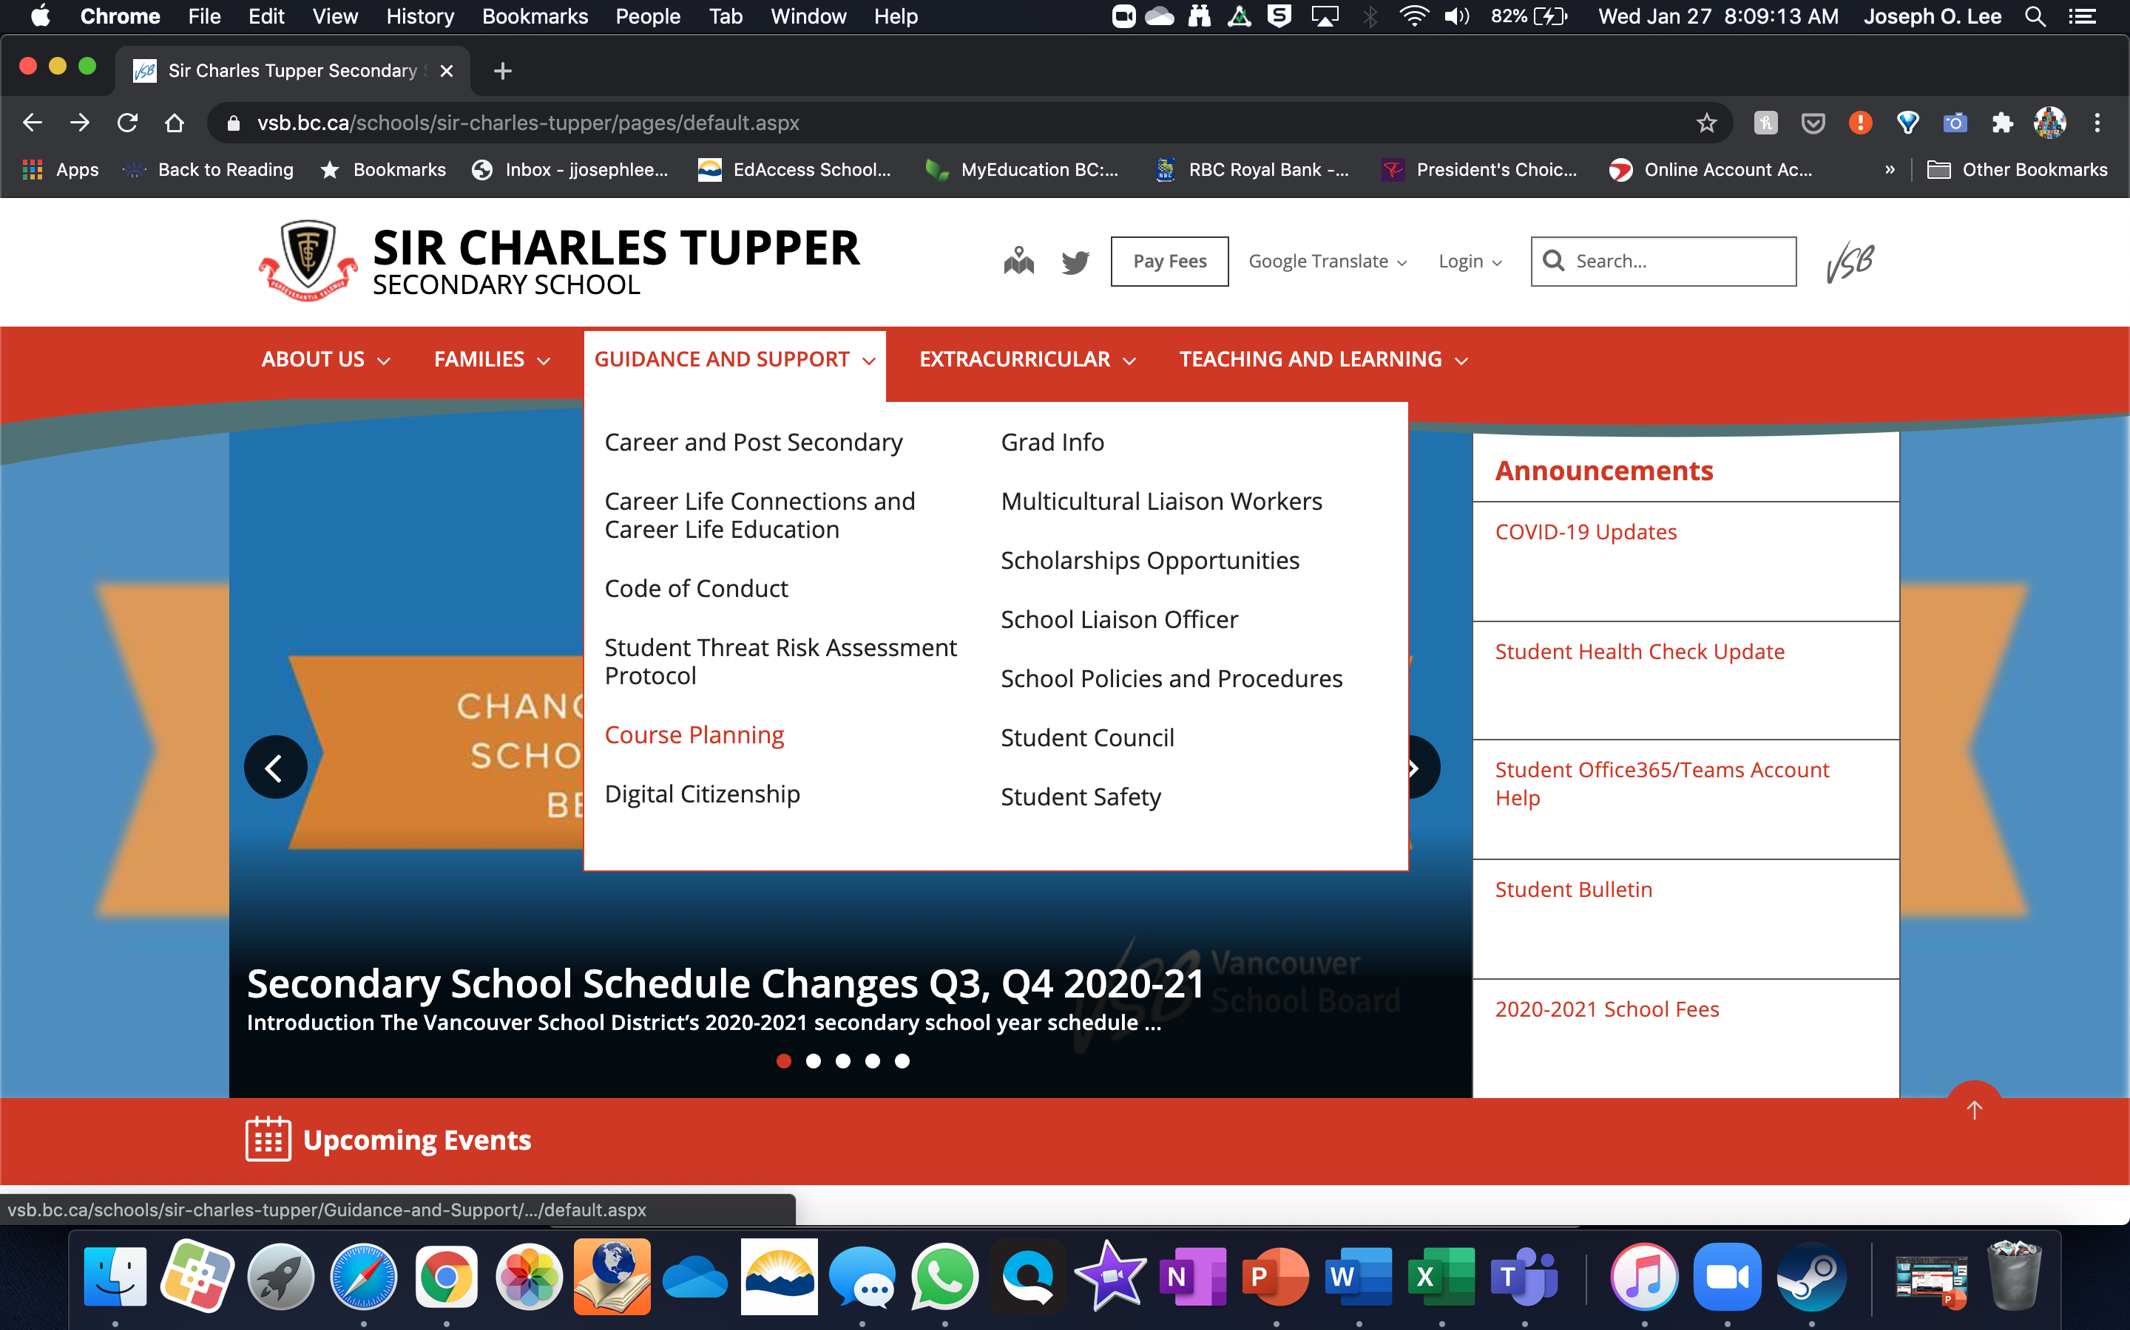

Slide 27
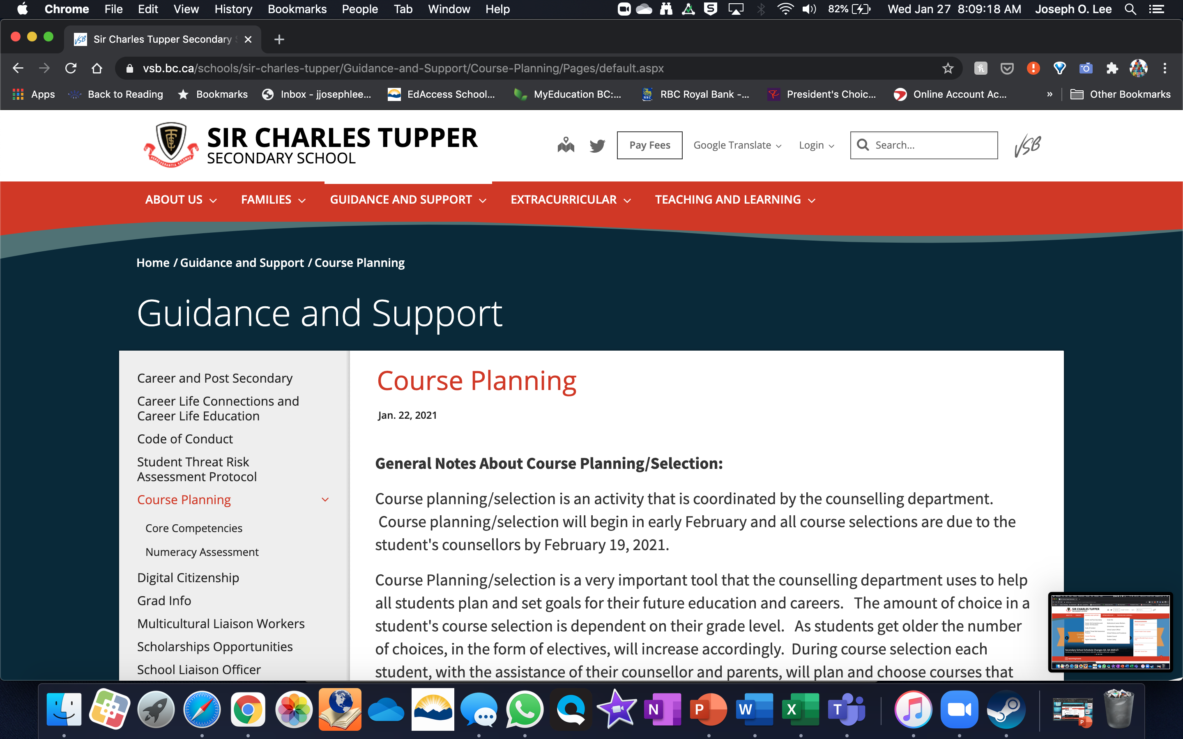

Slide 28
How do I submit my course Selections?
Once you’ve made your decisions and after consulting with your parents, you MUST complete the Course Selection Form on the Grade 10 MS Teams Channel

Slide 29
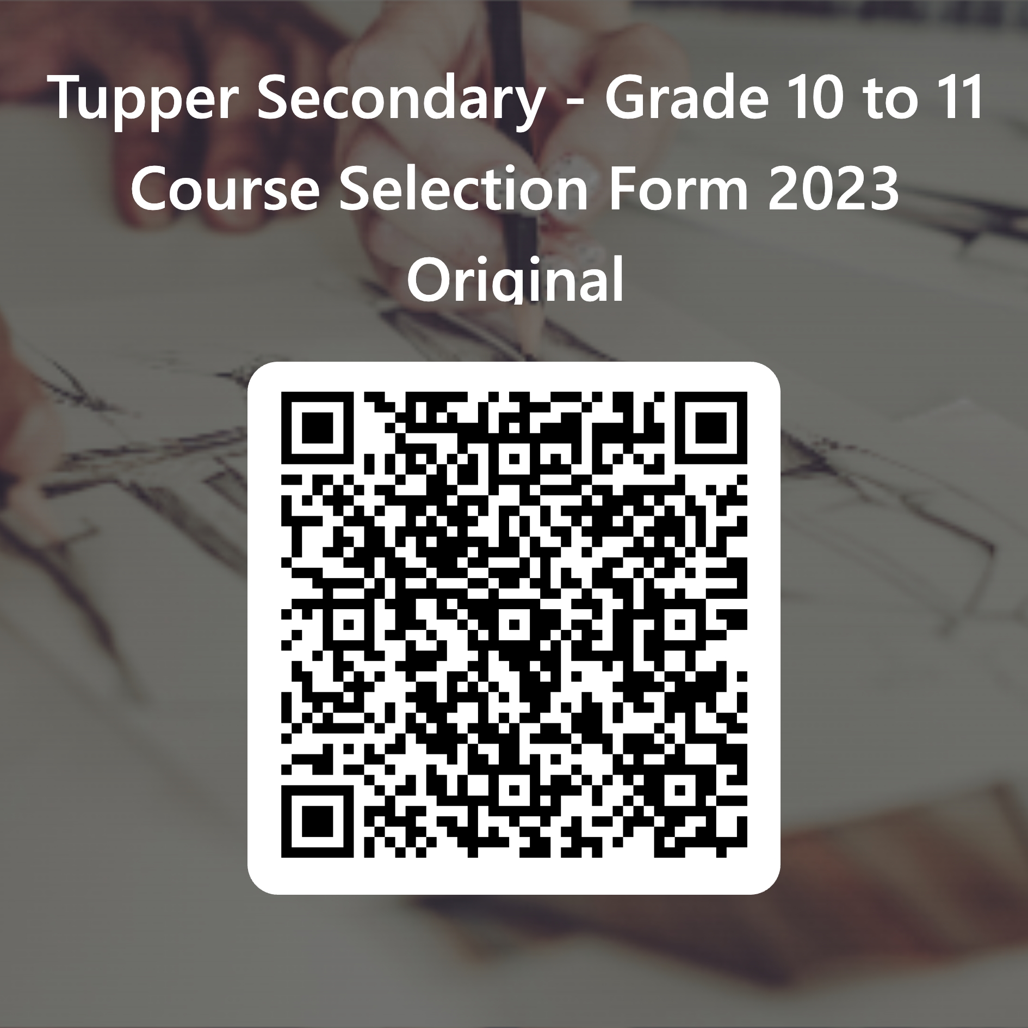
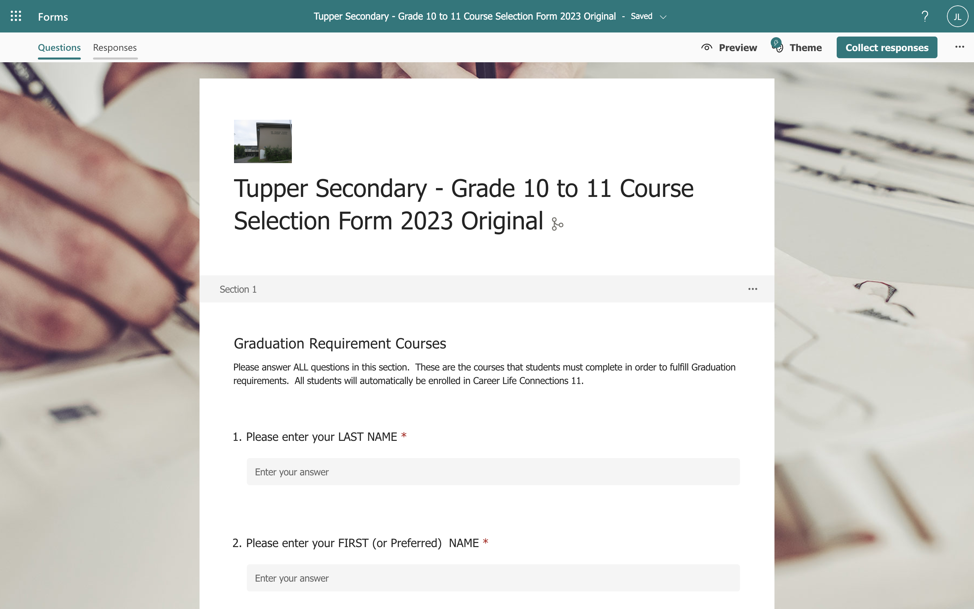
MS Forms – Course Selection
Click the link for your access to your Course Selection form HERE or use the QR code.

Slide 30
How Your Schedule is Made
Once everyone’s courses are requested, we spend months building the timetable
Factors that impact how the timetable is made: number of people requesting a course, teacher’s work schedules, room availability, student support needs, and overall operating budget/staffing.

Slide 31
More questions?
Please join us with your parents on February 1, 2023 at 430pm for our Course Planning Q + A night. This is just for the Grade 10s going into Grade 11
Contact Mr. Lee and set an appointment at jolee@vsb.bc.ca

